Slide 1
Team 5: CodeClash
Team Members:
Palveet Kaur Saluja (psaluja2),
Rudrik Sanmukhlal Patel (rudrikp2)

Slide 2
Introduction to CodeClash
Code generation and execution platform using LLMs.
Purpose: Presenting a web-based application that leverages state-of-the-art Language Large Models (LLMs) for code generation.
Capabilities: Generate, edit, and directly execute code across more than 40 programming languages.
Unique Selling Point: Comparison of outputs from various LLMs like GPT-3.5 / 4 and Gemini side-by-side to select the best code solutions.

Slide 3
Motivation
Problem Identification: Current LLM platforms do not allow editable or comparable code generation directly in their interfaces.
User Need: A tool that simplifies the process of generating, editing, and comparing code, enhancing learning and development for coders at all levels.
Significance: CodeClash offers a user-friendly solution that saves time and enhances the coding experience by providing editable and comparable code outputs directly.

Slide 4
Proposed Solution
CodeClash, a platform that integrates code generation, editing, execution, and comparison in a single interface.
Functionalities: Users can input descriptive coding problems in natural language, generate code using LLMs, and evaluate the efficiency and correctness of the generated code.
Benefits: Streamlines the code generation process and offers a way for selecting the most effective solutions.

Slide 5
Implementation
User Interaction: Interface allows for input of problem descriptions, user inputs, and expected outputs to ensure accurate code generation.
Evaluation Metrics: Includes runtime metrics like execution time, memory usage, and success status.
Example: "Code compiled and executed in 11ms, using 1024 kb of memory, with a status of success."

Slide 6
Tech Stack
Frontend: React.js and TailwindCSS for a responsive and stylized user interface.
Backend: Python, Flask for server-side operations, and APIs from OpenAI and Google for LLM integration.
Code Execution: Judge0 API, supported by RapidAPI for code compilation and execution.
Code Editor: Monaco Editor for an enriched coding and editing experience.

Slide 7
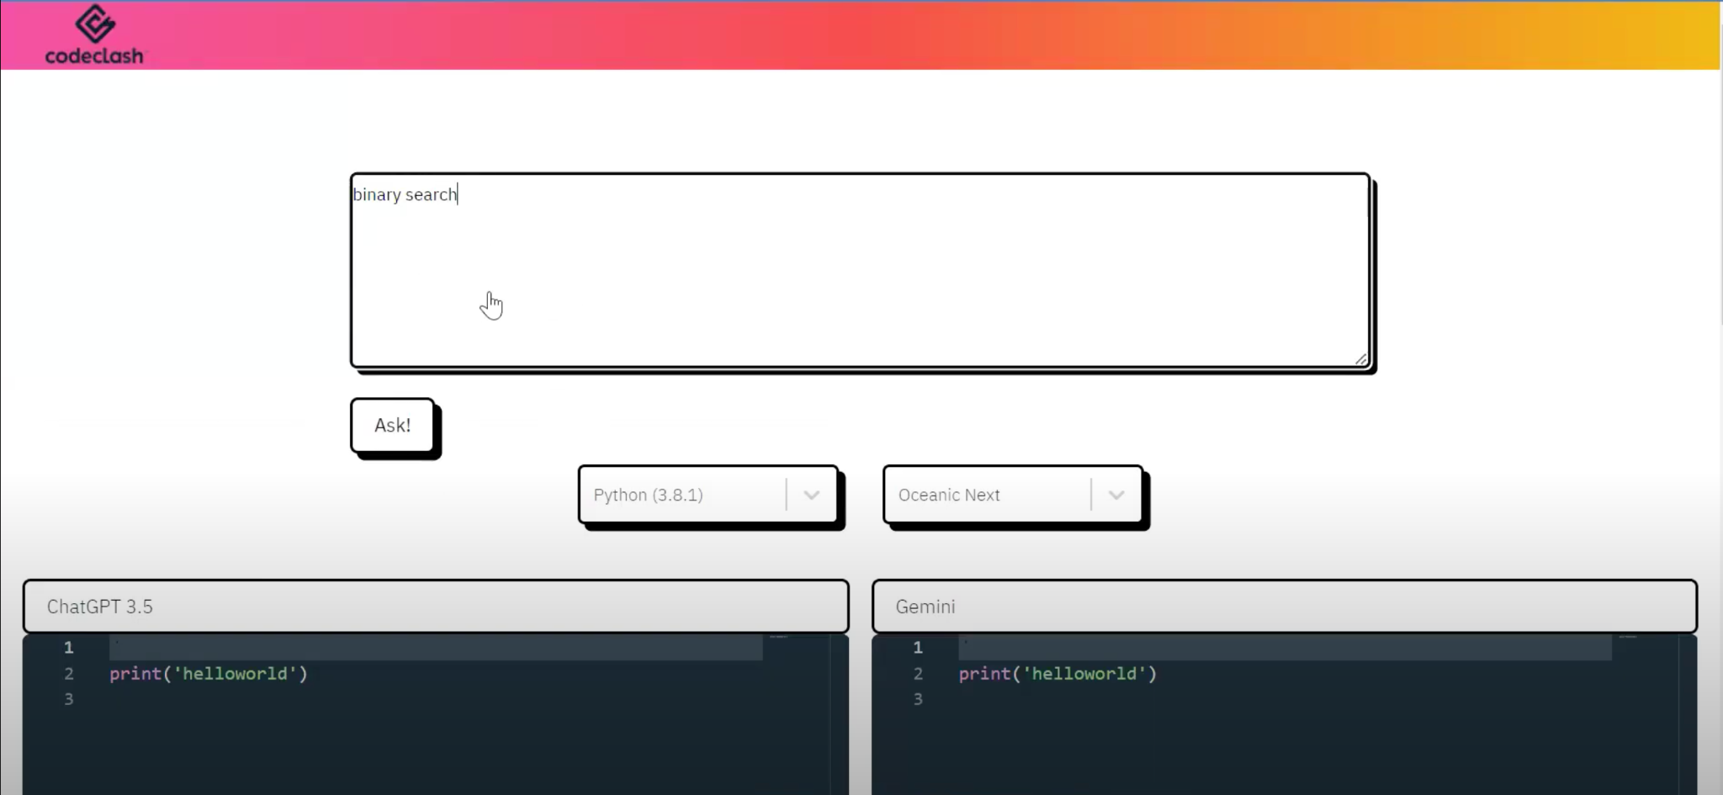
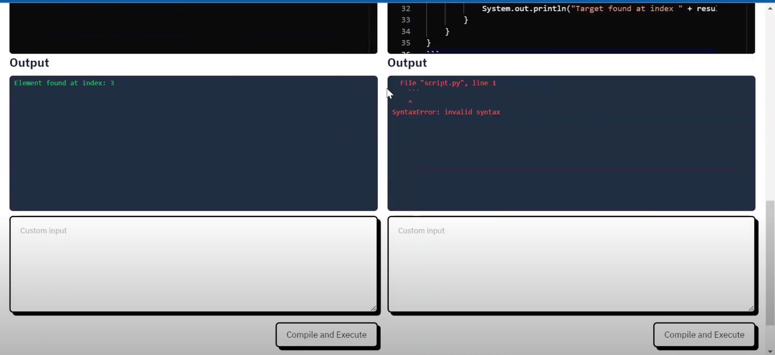
Workflow of Tool
User Prompt Input
LLM Code Generation
Code Display
User Input (if required)
Execute & Compare

Slide 8
Relevant links and Setup instructions
Github Link: https://github.com/Palveet/CS510-CodeClash
Demo Link: https://drive.google.com/file/d/1eIYyOh0VoF6glV5r77QLiasvspxrdeot/view
Setup Instructions:
1. clone the github repository : https://github.com/Palveet/CS510-CodeClash
2. npm install for react libraries
3. pip install - flask, cors, google.generative ai and open ai
4. add API keys for OPENAI and Gemini in /backend/app.py file
5. Make .env file to save RAPIDAPI_HOST and RAPIDAPI_KEY
REACT_APP_RAPID_API_HOST = YOUR_HOST_URL
REACT_APP_RAPID_API_KEY = YOUR_SECRET_KEY
REACT_APP_RAPID_API_URL = YOUR_SUBMISSIONS_URL
6. running react app : npm run start
7. running flask app : flask --app app --debug run
8. Use the tool: entering a prompt in the text area.

Slide 9
Group Members Contribution
Frontend: The majority of the frontend work was handled by Palveet (psaluja2).
Backend: The majority of the backend work was handled by Rudrik (rudrikp2).
As a group of only 2 individuals, we collaborated and worked together in both areas to finish the project.

Slide 10
Future Work and Improvements
To add other LLMs (Claude, Llama3, Mistral) use a cloud-hosted LLM service, such as Groqcloud.
Development Roadmap: Introduction of user accounts, code sharing features, and interactive pair programming capabilities.
User Prompts and Generated Code can be saved to create a dataset
Enhancements:
Login and Registration module for personalized experiences.
Custom user dashboards similar to CodePen.
Bookmarking favorite code snippets.
Sharing code snippets over the internet.
Collaborative coding using Socket Programming.
Limitations:
Judge0's basic plan: 100 requests/day.
OpenAI API is not free
Soon gemini will also charge (Pay-as-you-go)

Slide 11
Thank You :)

